Slide 1
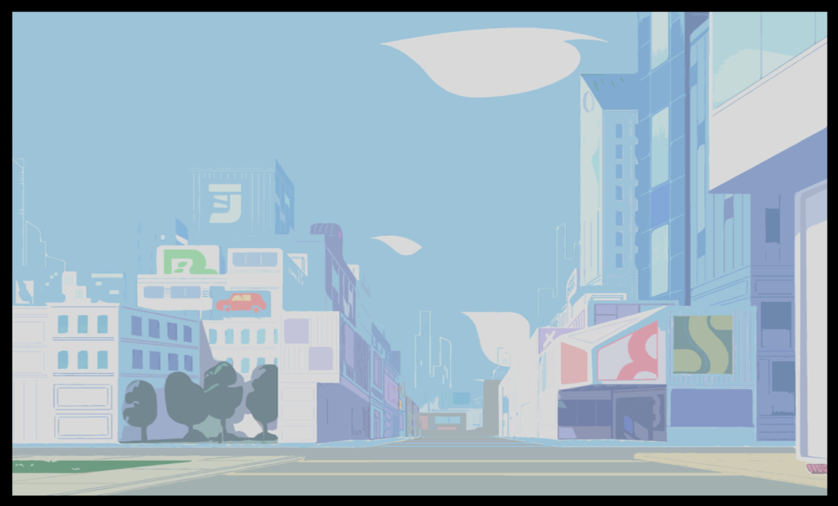



ASKMATE
SPRINT 3
BY
BENYEDLI, GUSZTORKA, NITRANKA & BOGONIUM PROFESSOR

Slide 2
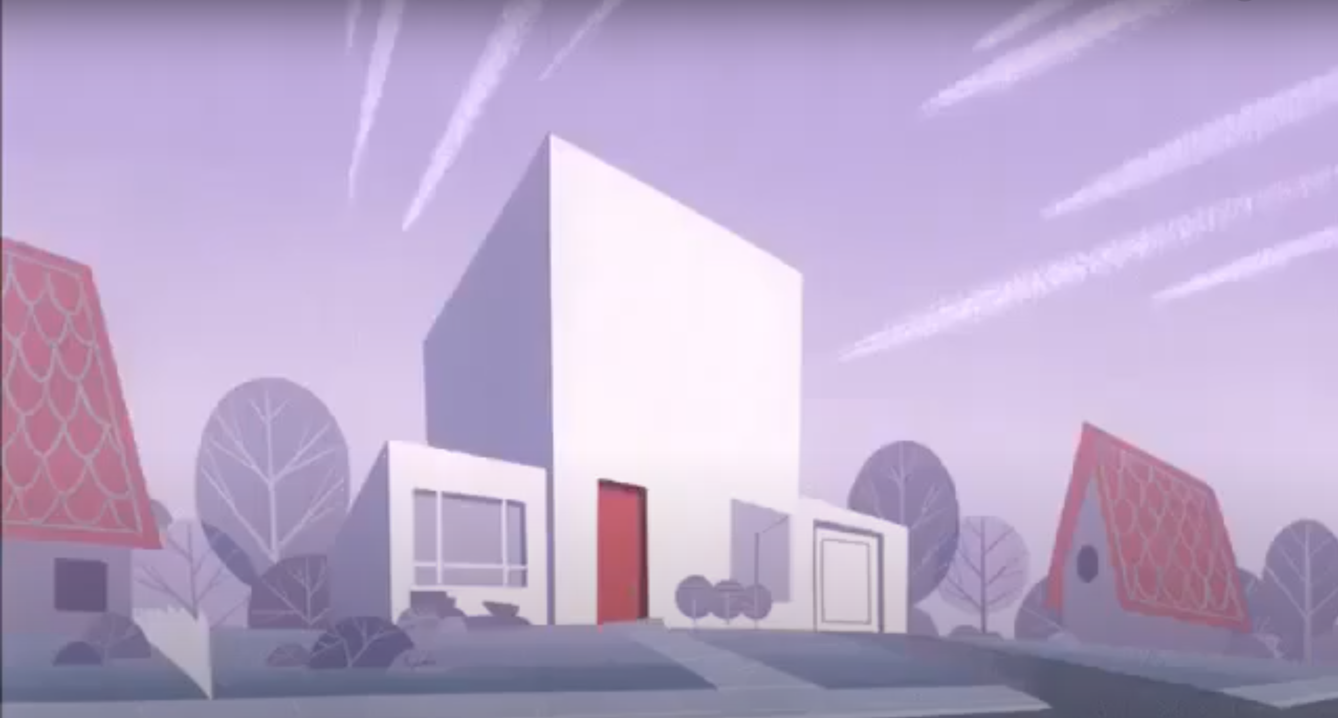
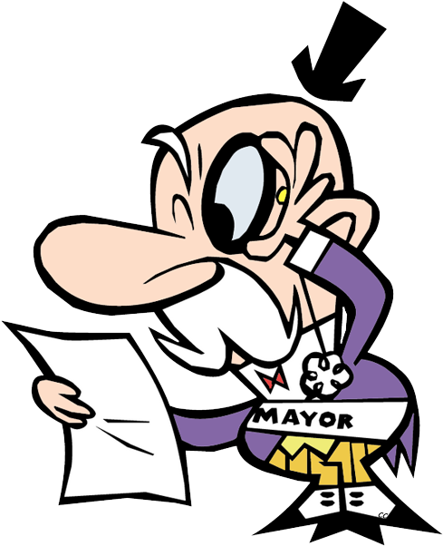

ASKMATE PROJECT
The mayor of Townsville asked me to develop a project called Askmate. It was a semi-finished work, it would have been a difficult task for only one person. I needed some helpers and I called the local heroes of Townsville....

Slide 3


Slide 4
POWERPUFF PROGRAMMERS IN THIS PROJECT
We implemented a site for users to ask questions, answer them, comment, vote up, vote down and search.
SQL, HTML, CSS, Python (Jinja) and a bit of JavaScript.
Learned some advanced git usage
Complex project

Slide 5

TASKS
TASK 1:
Login/register function. Visible features for logged in individuals.
TASK 2:
Redesign the page + lots of tiny adjustments to make it more usable.

Slide 6
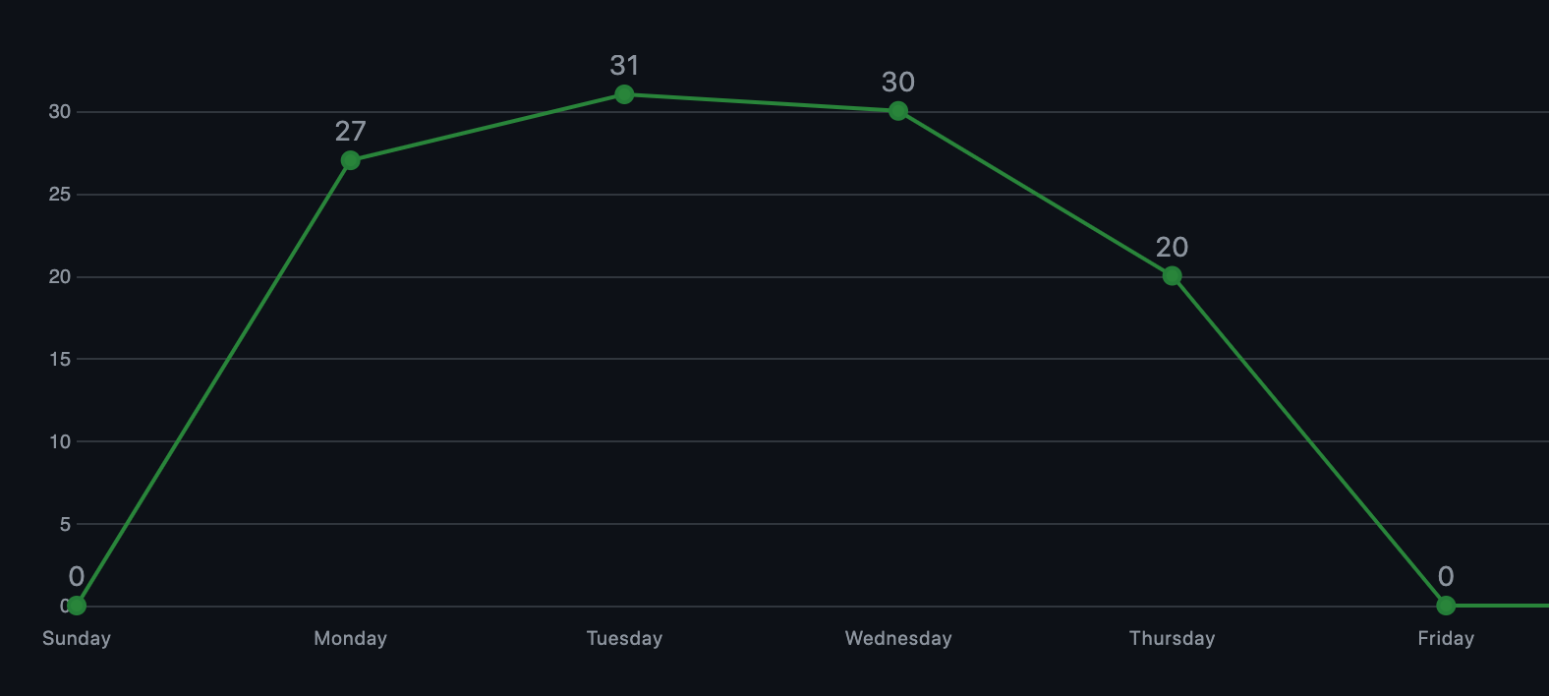
COMMIT HISTORY
Most succesful Monday ever!

Slide 7
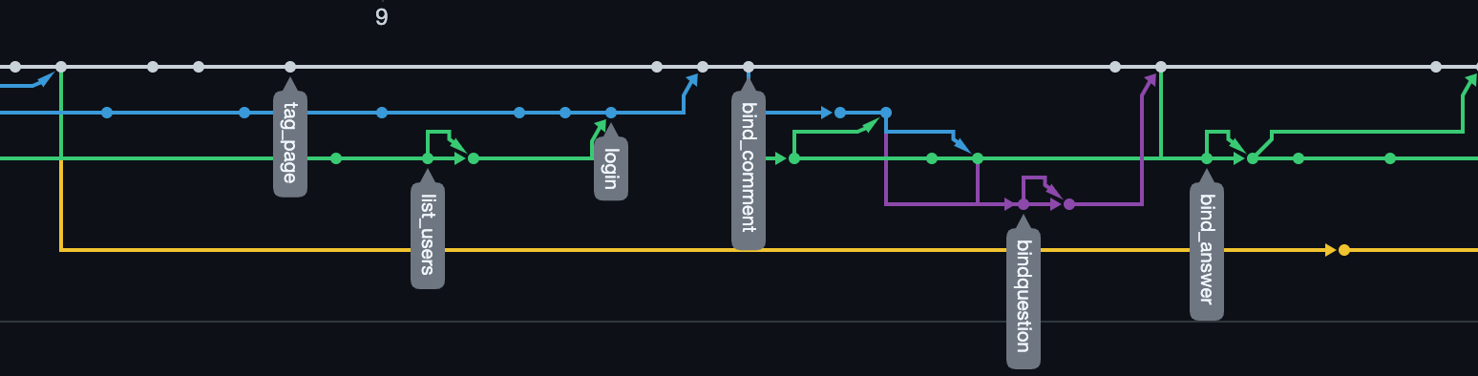
BRANCHES
FIRST TIME WE USED BRANCHES FOR THE DIFFERENT FEATURES.

Slide 8
NEW FEATURES
Register/login
presented by Benyedli
Drag and drop image upload
presented by Benyedli
User page, users list
presented by Gusztorka
Safety system
presented by Gusztorka
Bonus questions
presented by Nitranka

